Slide 1
Mixed Integer Programming

Slide 2
Contents
Review – MILP
Binary Variables
  Knapsack Example
  Set Covering Problem Example
  Purchasing Problem

Slide 3
Blank Slide

Slide 4
Review

Slide 5
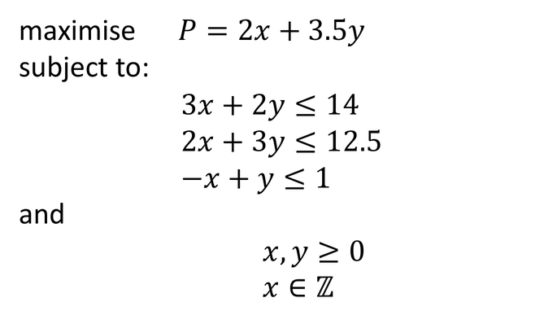
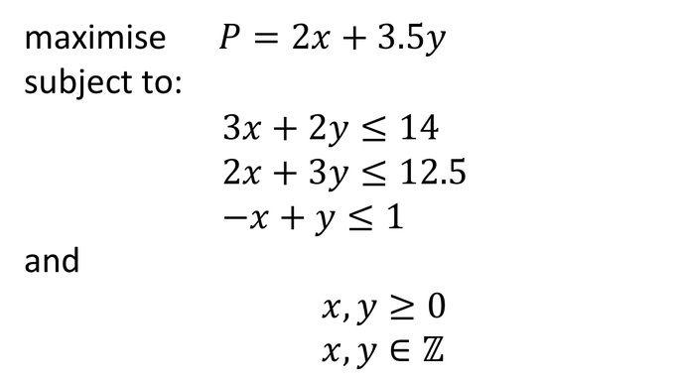
What is a Mixed-Integer Linear Program
Linear Objective
Linear Constraints
Some or all of the decision variables are restricted to be integers
e.g.
maximise $P=2x+3.5y$
subject to:
$$3x+2y≤14 \\ 2x+3y≤12.5 \\ −x+y≤1$$
and
$x,y≥0$
$x,y∈ℤ$
maximise $P=2x+3.5y$
subject to:
$$3x+2y≤14 \\ 2x+3y≤12.5 \\ −x+y≤1$$
and
$x,y≥0$
$x∈ℤ$

Slide 6

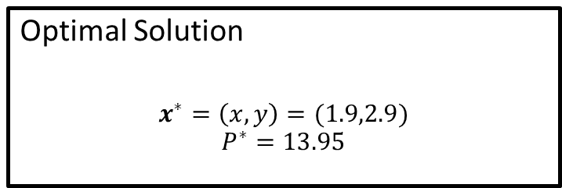


Linear Program Solution Without Integers
maximise $P=2x+3.5y$
subject to:
$$3x+2y≤14 \\ 2x+3y≤12.5 \\ −x+y≤1$$
and
$x,y≥0$
$$P=2x+3.5y$$
Optimal Solution
$$x^{∗}=\left(x,y\right)=(1.9,2.9)$$
$$P^{∗}=13.95$$

Slide 7
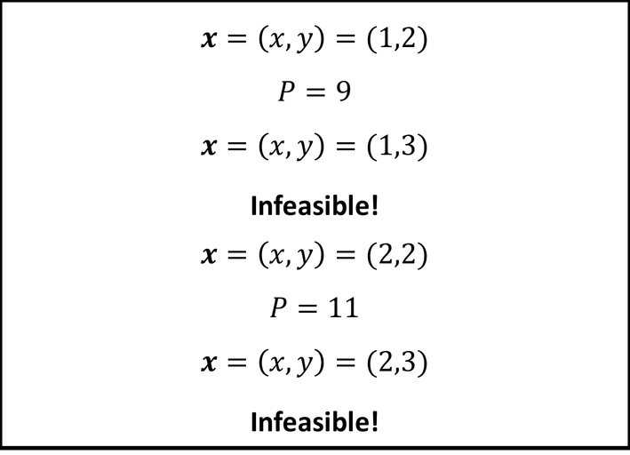
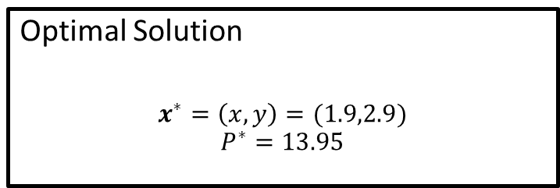
Rounded Solutions
Optimal Solution
$$x^{∗}=\left(x,y\right)=(1.9,2.9)$$
$$P^{∗}=13.95$$
$$P=2x+3.5y$$
$$x=\left(x,y\right)=(1,2)$$
$$P=9$$
$$x=\left(x,y\right)=(1,3)$$
Infeasible!
$$x=\left(x,y\right)=(2,2)$$
$$P=11$$
$$x=\left(x,y\right)=(2,3)$$
Infeasible!

Slide 8
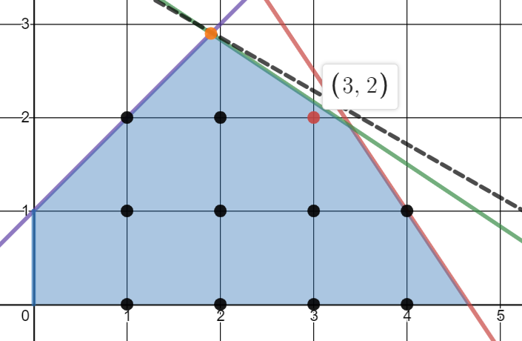
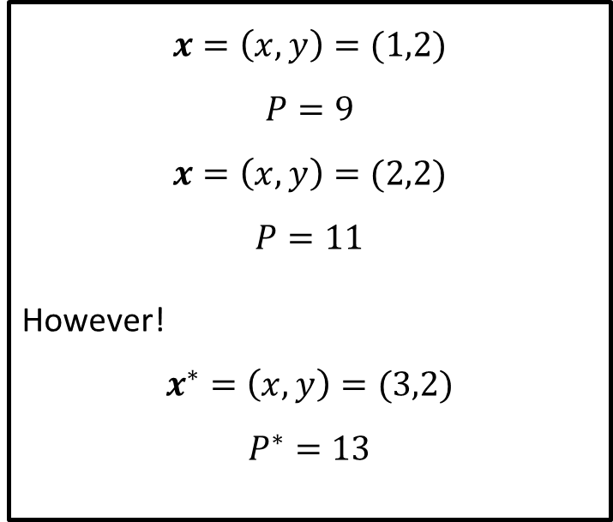

Rounded Solutions
$$x=\left(x,y\right)=(1,2)$$
$$P=9$$
$$x=\left(x,y\right)=(2,2)$$
$$P=11$$
However!
$$x^{∗}=\left(x,y\right)=(3,2)$$
$$P^{∗}=13$$
$$P=2x+3.5y$$

Slide 9
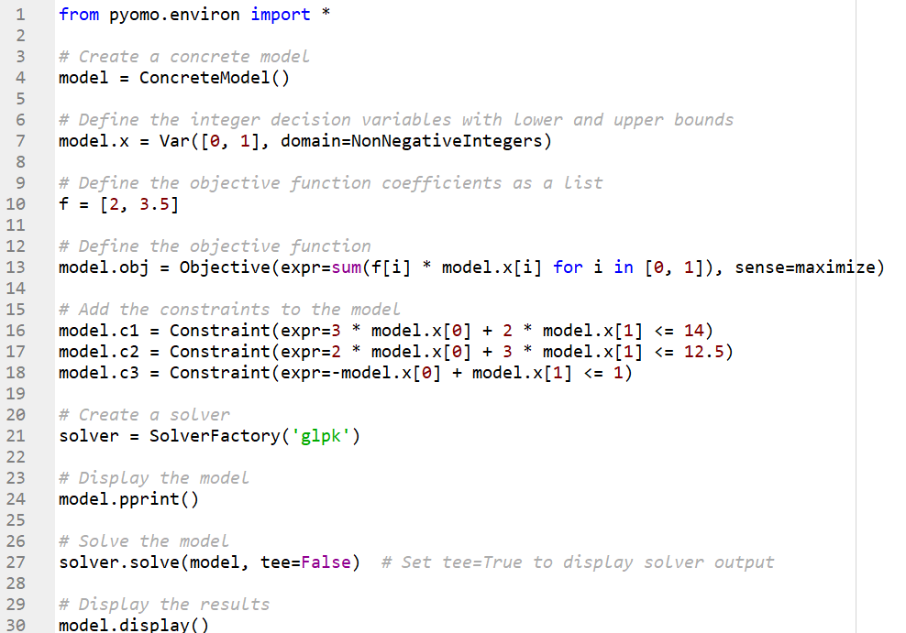

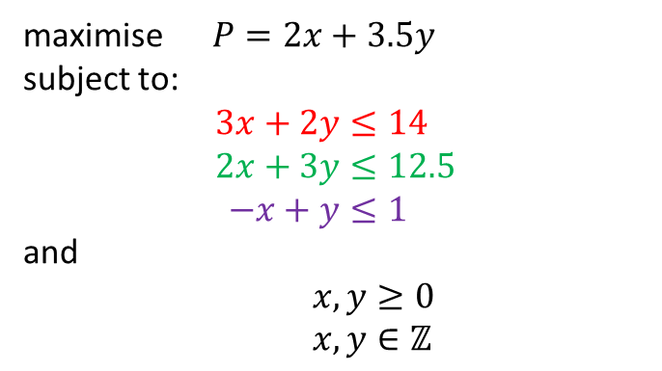
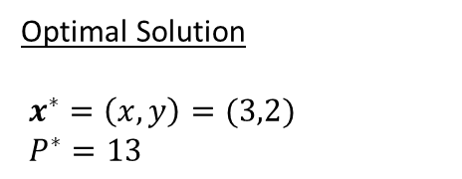
Integer Solution via Pyomo
maximise $P=2x+3.5y$
subject to:
$$3x+2y≤14 \\ 2x+3y≤12.5 \\ −x+y≤1$$
and
$x,y≥0$
$x,y∈ℤ$
Optimal Solution
$x^{∗}=\left(x,y\right)=(3,2)$
$P^{∗}=13$

Slide 10
Binary Variables

Slide 11
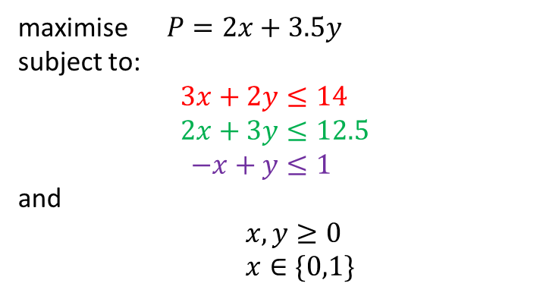
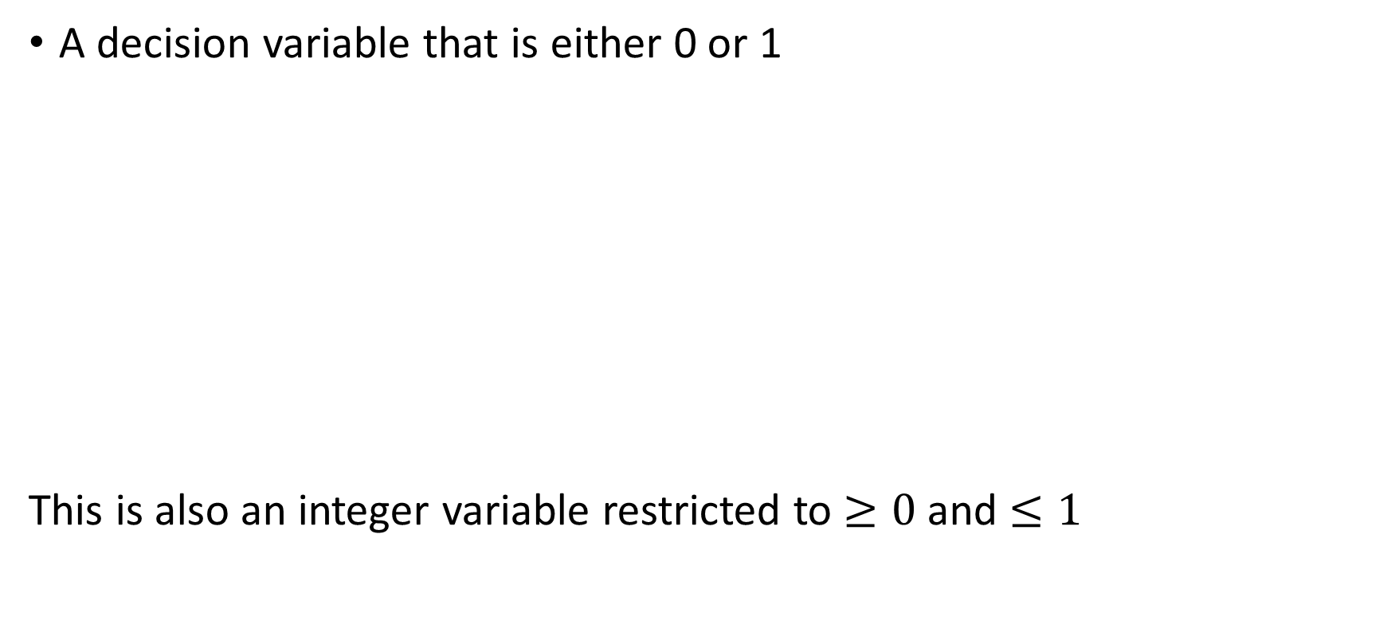
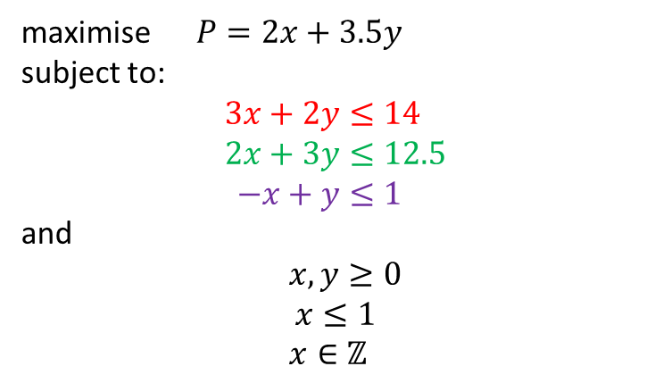
What is a Binary Variable
A decision variable that is either 0 or 1
This is also an integer variable restricted to $≥0$ and $≤1$
maximise $P=2x+3.5y$
subject to:
$$3x+2y≤14 \\ 2x+3y≤12.5 \\ −x+y≤1$$
and
$x,y≥0$
$x∈\{0,1\}$
maximise $P=2x+3.5y$
subject to:
$$3x+2y≤14 \\ 2x+3y≤12.5 \\ −x+y≤1$$
and
$x,y≥0$
$$x≤1$$
$x∈ℤ$

Slide 12

Knapsack Problem
7 items, can only carry 10kg, which to pick to maximise value?
£10
2kg
£10
2kg
£10
2kg
£100
6kg
£100
6kg
10kg
£130
8kg
£70
3kg

Slide 13
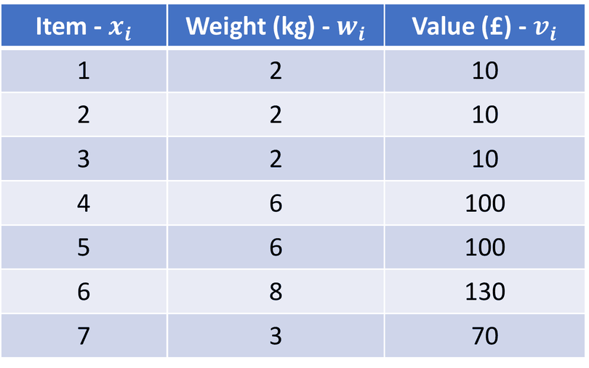

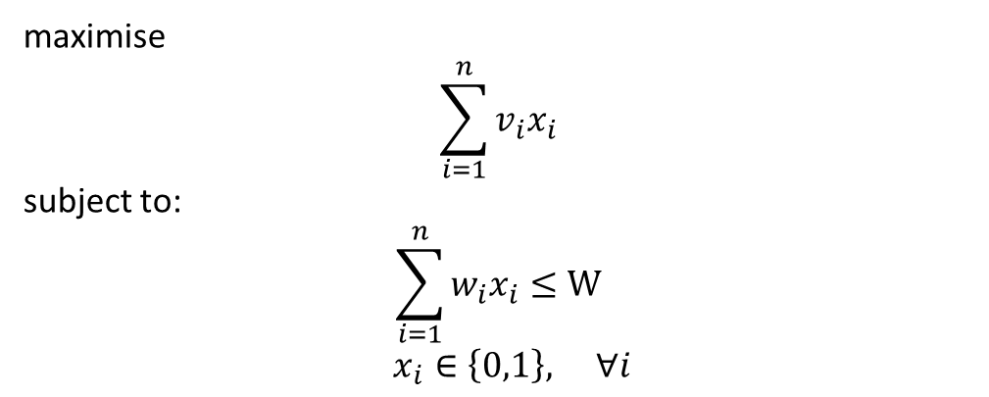

Knapsack Problem
For $n$ items and a capacity $W$
Item - $x_{i}$ | Weight (kg) - $w_{i}$ | Value (£) - $v_{i}$
1 | 2 | 10
2 | 2 | 10
3 | 2 | 10
4 | 6 | 100
5 | 6 | 100
6 | 8 | 130
7 | 3 | 70
maximise
$$\sum_{i=1}^{n}{v_{i}x_{i}}$$
subject to:
$$\sum_{i=1}^{n}{w_{i}x_{i}}≤W$$
$x_{i}∈\left\{0,1\right\}, ∀i$
For our example $n=7$ and $W=10$

Slide 14
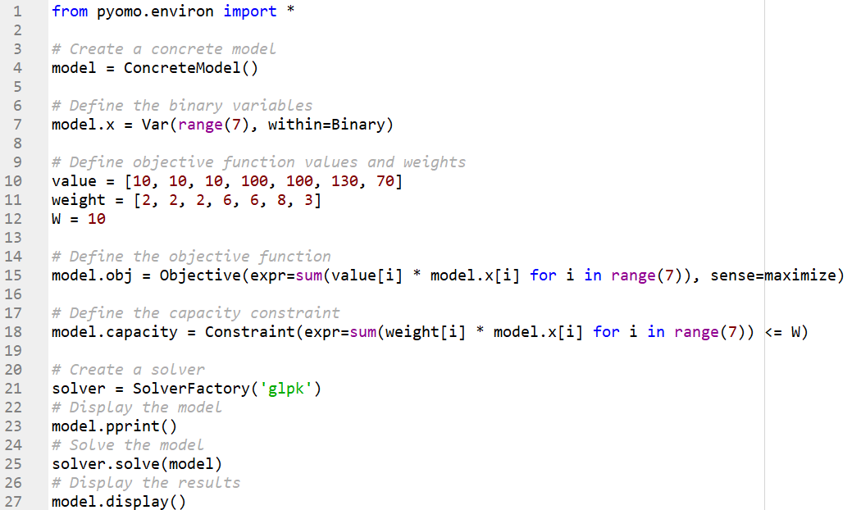
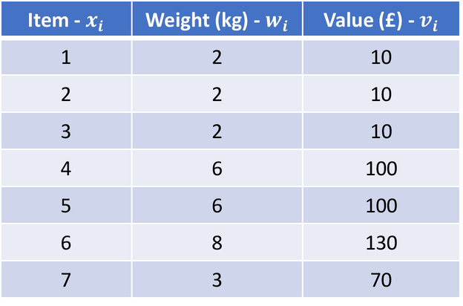
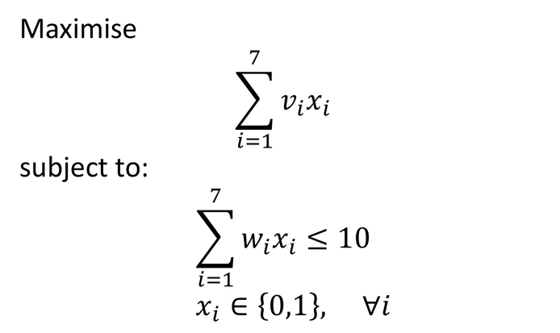
Knapsack Problem via Pyomo
Maximise
$$\sum_{i=1}^{7}{v_{i}x_{i}}$$
subject to:
$$\sum_{i=1}^{7}{w_{i}x_{i}}≤10$$
$x_{i}∈\left\{0,1\right\}, ∀i$
Item - $x_{i}$ | Weight (kg) - $w_{i}$ | Value (£) - $v_{i}$
1 | 2 | 10
2 | 2 | 10
3 | 2 | 10
4 | 6 | 100
5 | 6 | 100
6 | 8 | 130
7 | 3 | 70

Slide 15
Set Covering Problem - Fire Stations Example
There are six cities in region R. The region must determine where to build fire stations.
The region wants to build the minimum number of fire stations and ensure that at least one fire station is within 15 minutes of each city.
The times (in minutes) required to drive between cities are:
City | 1 | 2 | 3 | 4 | 5 | 6
1 | 0 | 10 | 20 | 30 | 30 | 20
2 | 10 | 0 | 25 | 35 | 20 | 10
3 | 20 | 25 | 0 | 15 | 30 | 20
4 | 30 | 35 | 15 | 0 | 15 | 25
5 | 30 | 20 | 30 | 15 | 0 | 14
6 | 20 | 10 | 20 | 25 | 14 | 0

Slide 16
Set Covering Problem - Fire Stations Example
Think of the cities as a network.
Keep only the links of 15 minutes or less (entries ≤ 15 in the table).
City | 1 | 2 | 3 | 4 | 5 | 6
1 | 0 | 10 | 20 | 30 | 30 | 20
2 | 10 | 0 | 25 | 35 | 20 | 10
3 | 20 | 25 | 0 | 15 | 30 | 20
4 | 30 | 35 | 15 | 0 | 15 | 25
5 | 30 | 20 | 30 | 15 | 0 | 14
6 | 20 | 10 | 20 | 25 | 14 | 0
By inspection, build in cities 2 and 4.
Covers 1,2,6 and 3,4,5.

Slide 17
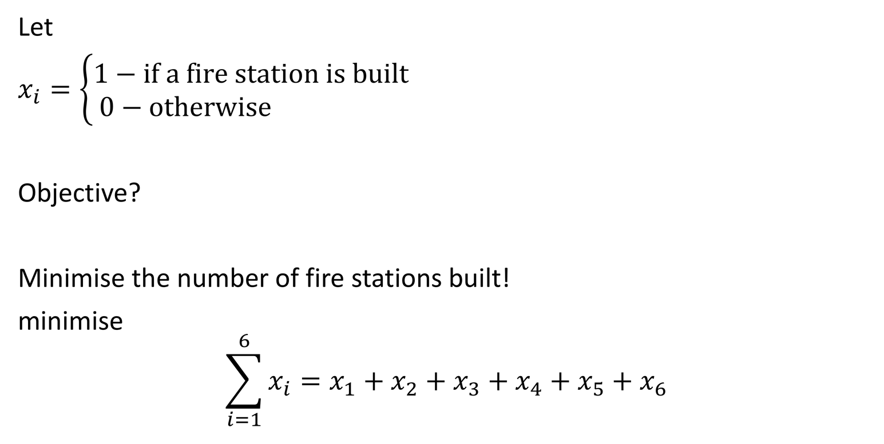
Set Covering Problem - Fire Stations Example
City | 1 | 2 | 3 | 4 | 5 | 6
1 | 0 | 10 | 20 | 30 | 30 | 20
2 | 10 | 0 | 25 | 35 | 20 | 10
3 | 20 | 25 | 0 | 15 | 30 | 20
4 | 30 | 35 | 15 | 0 | 15 | 25
5 | 30 | 20 | 30 | 15 | 0 | 14
6 | 20 | 10 | 20 | 25 | 14 | 0
Let
$x_{i}=\left\{\begin{aligned}1\text{ − }\text{if} \text{a} \text{fire} \text{station} \text{is} \text{built} \\ 0\text{ − }\text{otherwise} \end{aligned}\right.$
Objective?
Minimise the number of fire stations built!
minimise
$$\sum_{i=1}^{6}{x_{i}=x_{1}+x_{2}+x_{3}+x_{4}+x_{5}+x_{6}}$$

Slide 18
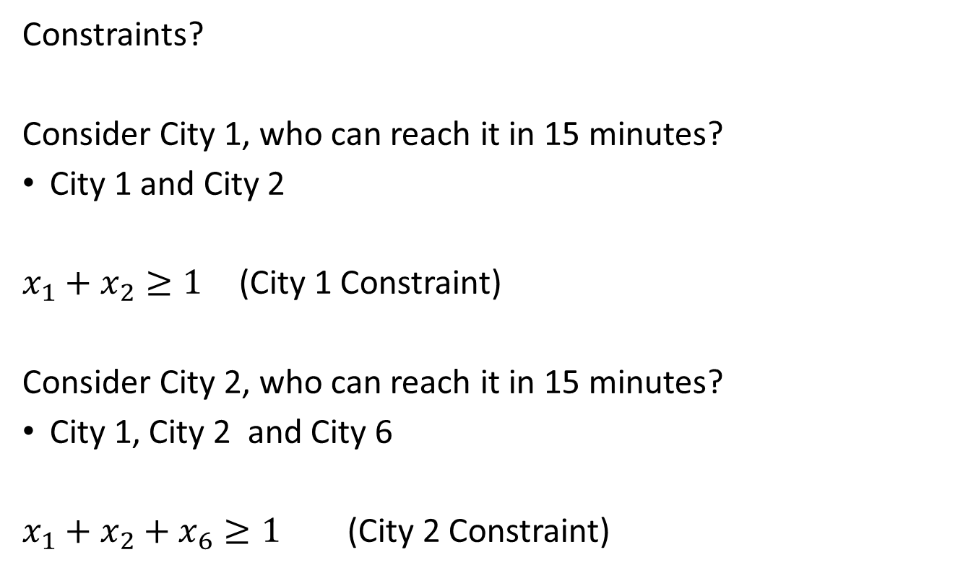
Set Covering Problem - Fire Stations Example
City | 1 | 2 | 3 | 4 | 5 | 6
1 | 0 | 10 | 20 | 30 | 30 | 20
2 | 10 | 0 | 25 | 35 | 20 | 10
3 | 20 | 25 | 0 | 15 | 30 | 20
4 | 30 | 35 | 15 | 0 | 15 | 25
5 | 30 | 20 | 30 | 15 | 0 | 14
6 | 20 | 10 | 20 | 25 | 14 | 0
Constraints?
Consider City 1, who can reach it in 15 minutes?
City 1 and City 2
$x_{1}+x_{2}≥1$ (City 1 Constraint)
Consider City 2, who can reach it in 15 minutes?
City 1, City 2 and City 6
$x_{1}+x_{2}+x_{6}≥1$ (City 2 Constraint)

Slide 19
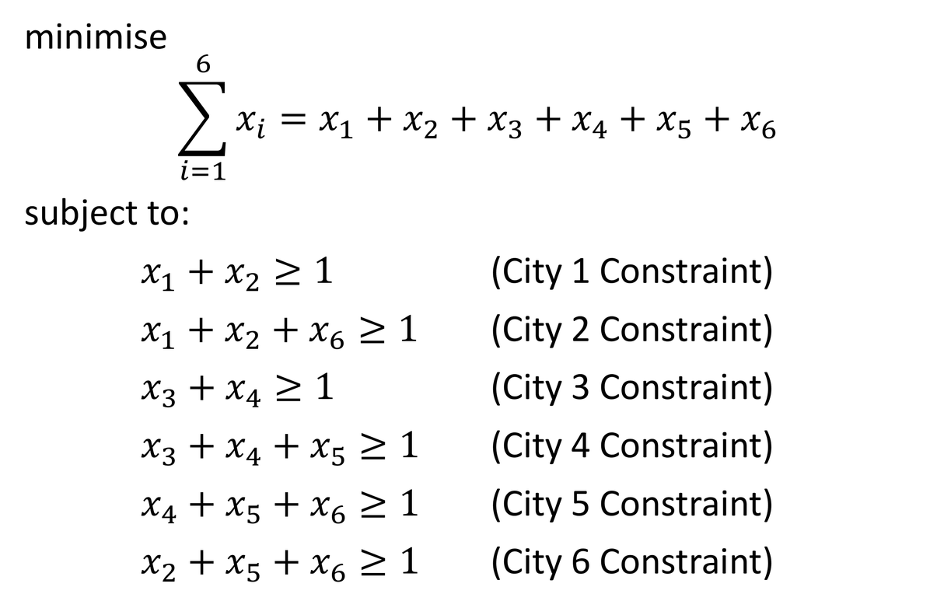
Set Covering Problem - Fire Stations Example
City | 1 | 2 | 3 | 4 | 5 | 6
1 | 0 | 10 | 20 | 30 | 30 | 20
2 | 10 | 0 | 25 | 35 | 20 | 10
3 | 20 | 25 | 0 | 15 | 30 | 20
4 | 30 | 35 | 15 | 0 | 15 | 25
5 | 30 | 20 | 30 | 15 | 0 | 14
6 | 20 | 10 | 20 | 25 | 14 | 0
minimise
$$\sum_{i=1}^{6}{x_{i}=x_{1}+x_{2}+x_{3}+x_{4}+x_{5}+x_{6}}$$
subject to:
$x_{1}+x_{2}≥1$ (City 1 Constraint)
$x_{1}+x_{2}+x_{6}≥1$ (City 2 Constraint)
$x_{3}+x_{4}≥1$ (City 3 Constraint)
$x_{3}+x_{4}+x_{5}≥1$ (City 4 Constraint)
$x_{4}+x_{5}+x_{6}≥1$ (City 5 Constraint)
$x_{2}+x_{5}+x_{6}≥1$ (City 6 Constraint)

Slide 20
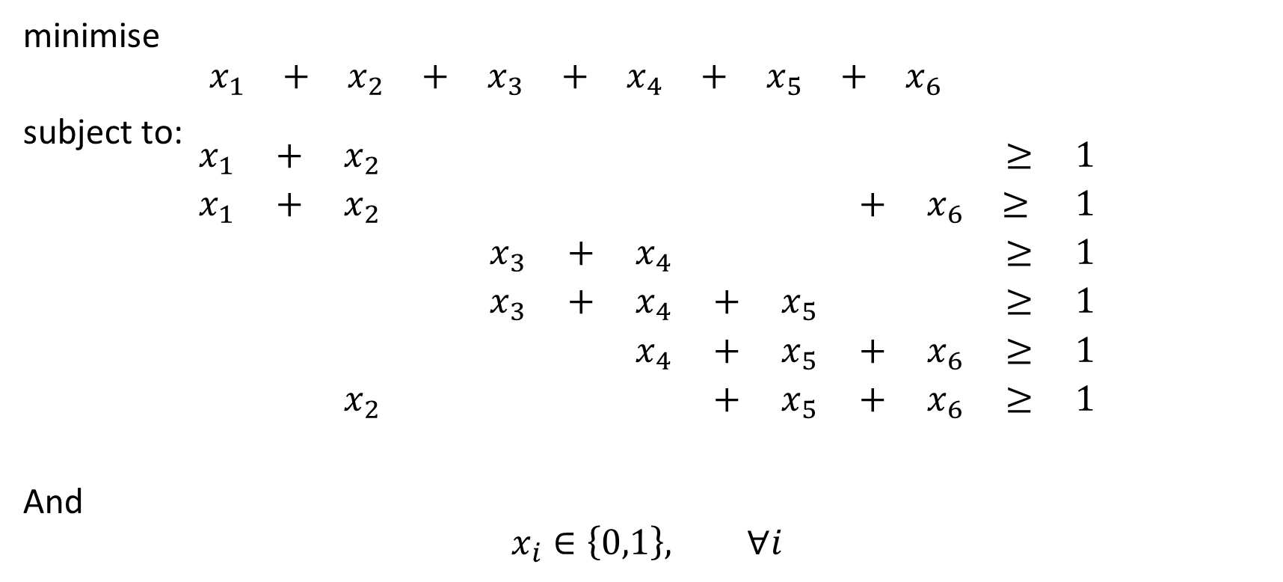
Set Covering Problem - Fire Stations Example
minimise
$$\begin{matrix}x_{1} & + & x_{2} & + & x_{3} & + & x_{4} & + & x_{5} & + & x_{6} & & \end{matrix}$$
subject to:
$$\begin{matrix}x_{1} & + & x_{2} & & & & & & & & & ≥ & 1 \\ x_{1} & + & x_{2} & & & & & & & + & x_{6} & ≥ & 1 \\ & & & & x_{3} & + & x_{4} & & & & & ≥ & 1 \\ & & & & x_{3} & + & x_{4} & + & x_{5} & & & ≥ & 1 \\ & & & & & & x_{4} & + & x_{5} & + & x_{6} & ≥ & 1 \\ & & x_{2} & & & & & + & x_{5} & + & x_{6} & ≥ & 1\end{matrix}$$
And
$$x_{i}∈\left\{0,1\right\}, ∀i$$

Slide 21
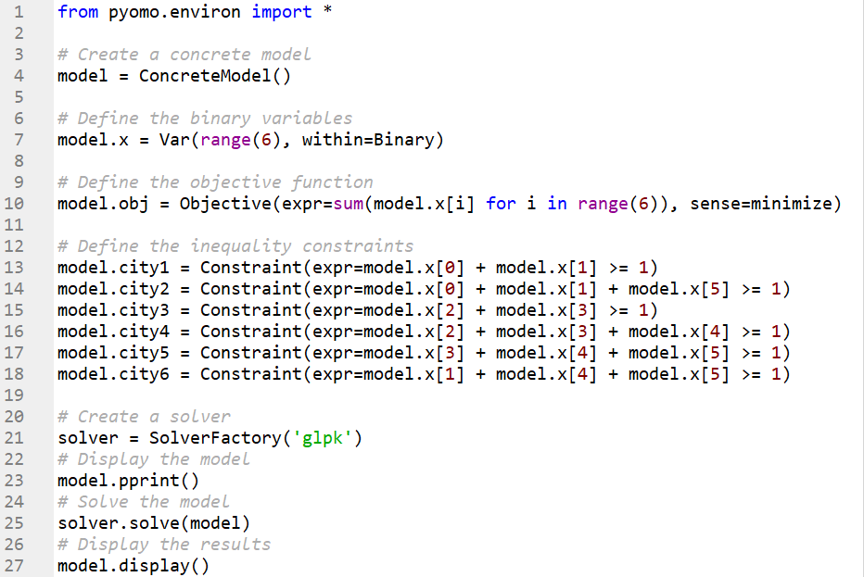
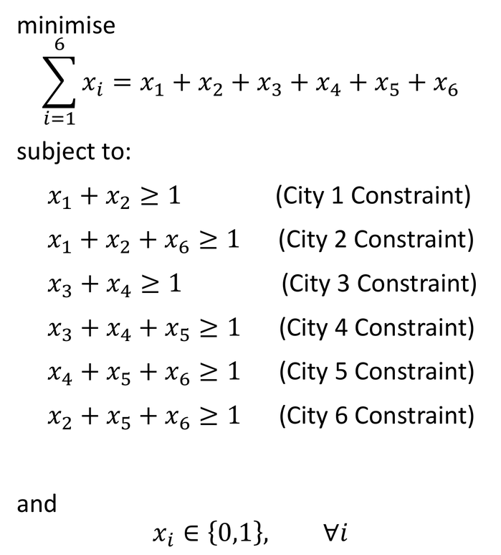
Set Covering Problem - Fire Stations Example
minimise
$$\sum_{i=1}^{6}{x_{i}=x_{1}+x_{2}+x_{3}+x_{4}+x_{5}+x_{6}}$$
subject to:
$x_{1}+x_{2}≥1$ (City 1 Constraint)
$x_{1}+x_{2}+x_{6}≥1$ (City 2 Constraint)
$x_{3}+x_{4}≥1$ (City 3 Constraint)
$x_{3}+x_{4}+x_{5}≥1$ (City 4 Constraint)
$x_{4}+x_{5}+x_{6}≥1$ (City 5 Constraint)
$x_{2}+x_{5}+x_{6}≥1$ (City 6 Constraint)
and
$$x_{i}∈\left\{0,1\right\}, ∀i$$

Slide 22
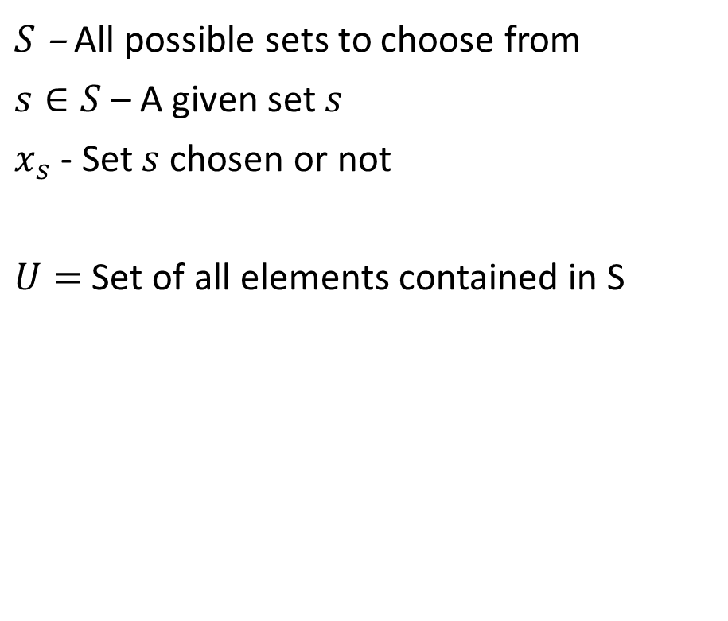
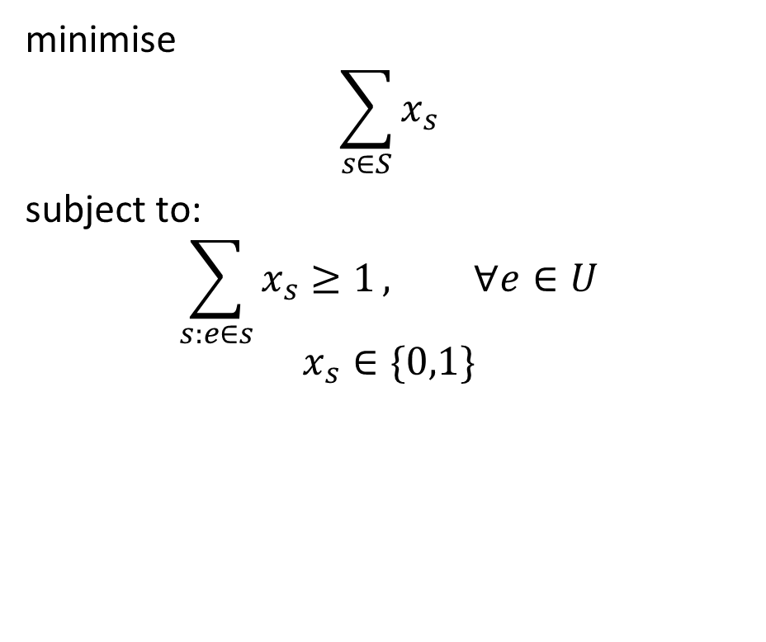
General Set Covering Problem
minimise
$$\sum_{s∈S}{x_{s}}$$
subject to:
$$\sum_{s:e∈s}{x_{s}≥1}, ∀e∈U$$
$$x_{s}∈\{0,1\}$$
$S$ – All possible sets to choose from
$s∈S$ – A given set $s$
$x_{s}$ - Set $s$ chosen or not
$U=$ Set of all elements contained in S

Slide 23
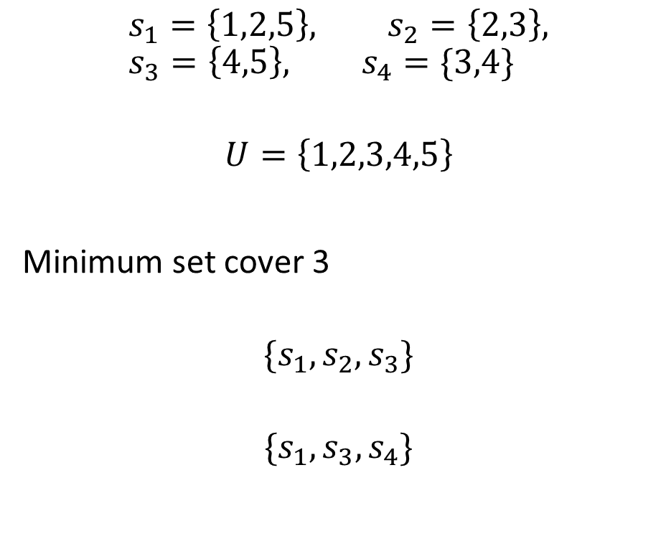
General Set Covering Problem
minimise
$$\sum_{s∈S}{x_{s}}$$
subject to:
$$\sum_{s:e∈s}{x_{s}≥1}, ∀e∈U$$
$$x_{s}∈\{0,1\}$$
$$s_{1}=\left\{1,2,5\right\}, s_{2}=\left\{2,3\right\}, s_{3}=\left\{4,5\right\}, s_{4}=\{3,4\}$$
$$U=\left\{1,2,3,4,5\right\}$$
Covers with 3 sets (the minimum is 2: {s1, s4})
$$\{s_{1},s_{2},s_{3}\}$$
$${\{s}_{1}, s_{3},s_{4}\}$$

Slide 24
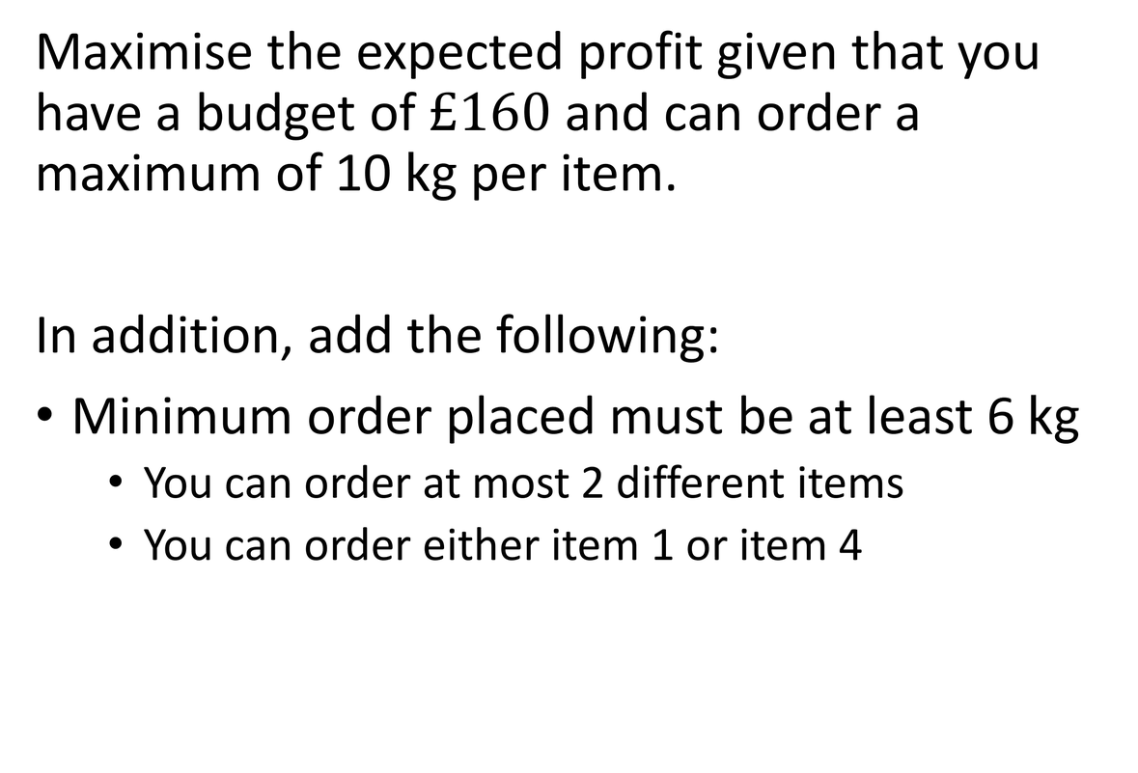
Purchasing Problem
Item | Cost (per kg) | Expected Profit (per kg)
1 | 10 | 5
2 | 12 | 3
3 | 9 | 4
4 | 5 | 3
5 | 13 | 3
Maximise the expected profit given that you have a budget of $£160$ and can order a maximum of 10 kg per item.
In addition, add the following:
Minimum order placed must be at least 6 kg
  You can order at most 2 different items
  You can order either item 1 or item 4

Slide 25
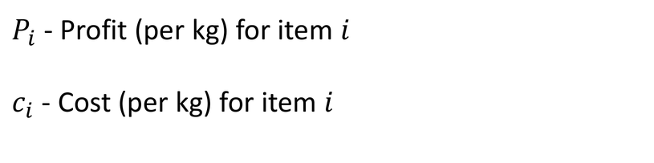
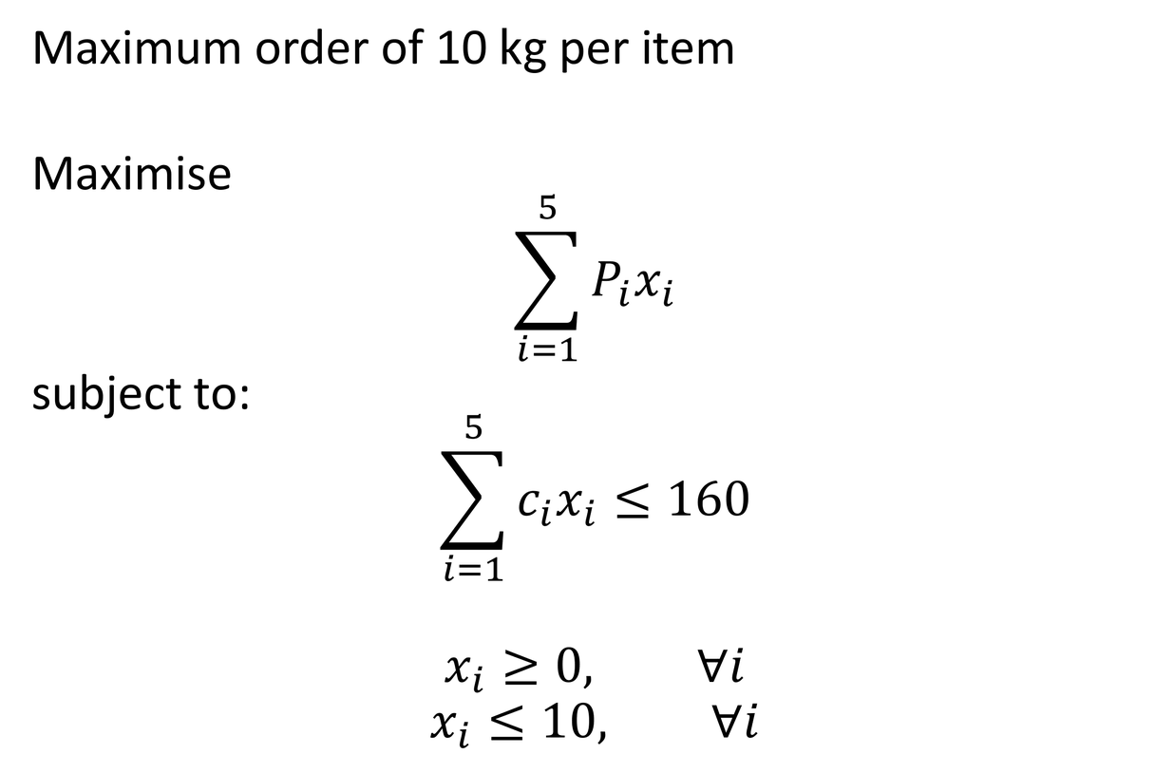
Basic Model
Item | Cost (per kg) | Expected Profit (per kg)
1 | 10 | 5
2 | 12 | 3
3 | 9 | 4
4 | 5 | 3
5 | 13 | 3
Maximum order of 10 kg per item
Maximise
$$\sum_{i=1}^{5}{P_{i}x_{i}}$$
subject to:
$$\sum_{i=1}^{5}{c_{i}x_{i}}≤160$$
$$x_{i}≥0, ∀i$$
$$x_{i}≤10, ∀i$$
$P_{i}$ - Profit (per kg) for item $i$
$c_{i}$ - Cost (per kg) for item $i$

Slide 26
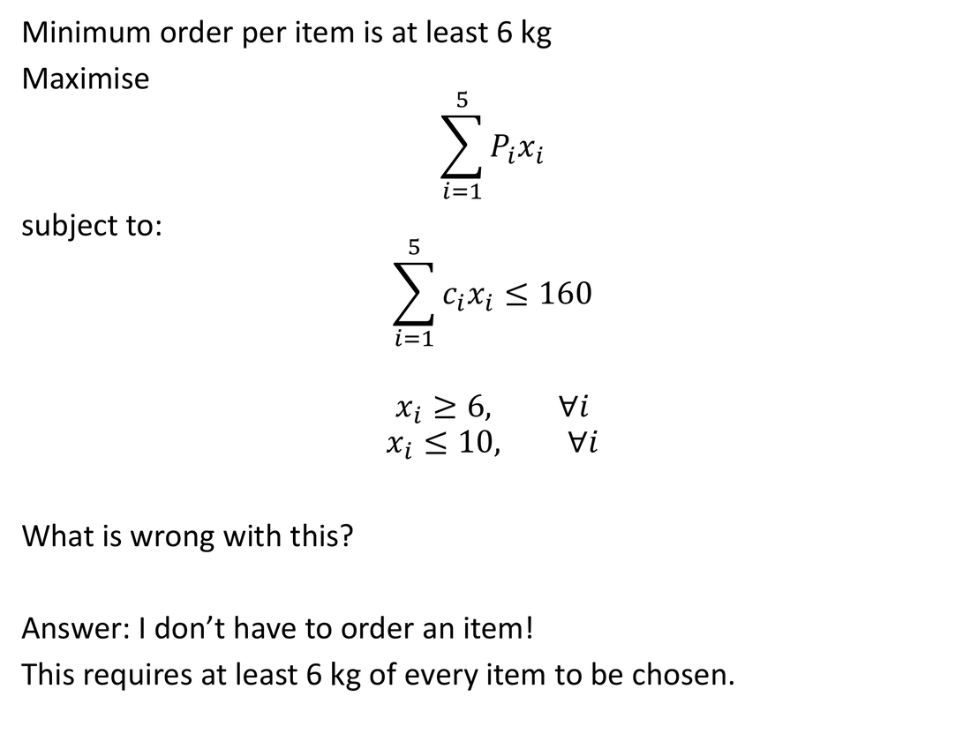
Updated Problem
Item | Cost (per kg) | Expected Profit (per kg)
1 | 10 | 5
2 | 12 | 3
3 | 9 | 4
4 | 5 | 3
5 | 13 | 3
Minimum order per item is at least 6 kg
Maximise
$$\sum_{i=1}^{5}{P_{i}x_{i}}$$
subject to:
$$\sum_{i=1}^{5}{c_{i}x_{i}}≤160$$
$$x_{i}≥6, ∀i$$
$$x_{i}≤10, ∀i$$
What is wrong with this?
Answer: I don’t have to order an item!
This requires at least 6 kg of every item to be chosen.
I want to say the following.
IF I choose to order an Item THEN
I must order at least 6 kg and at most 10 kg

Slide 27
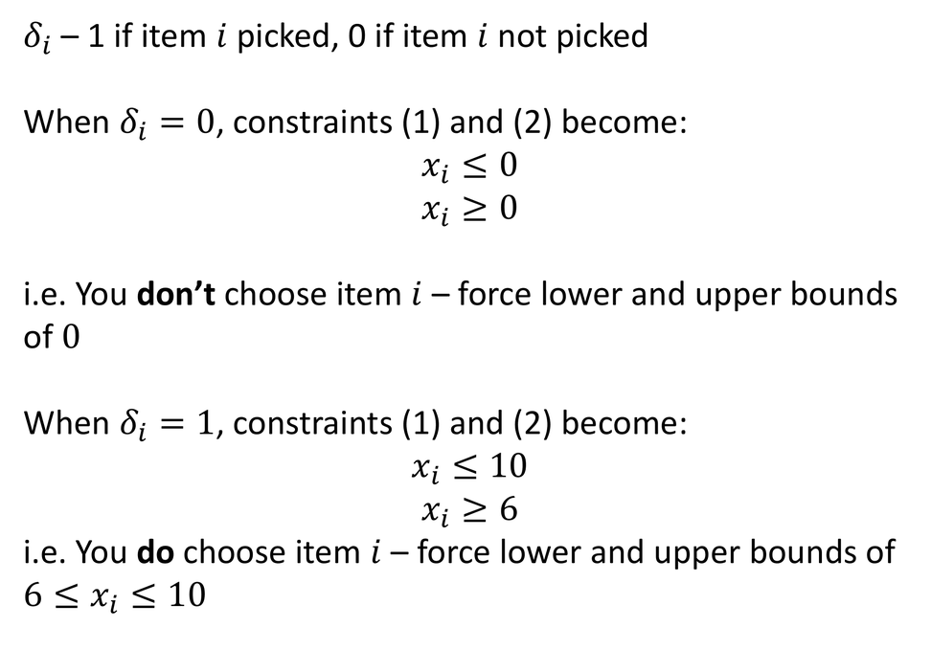
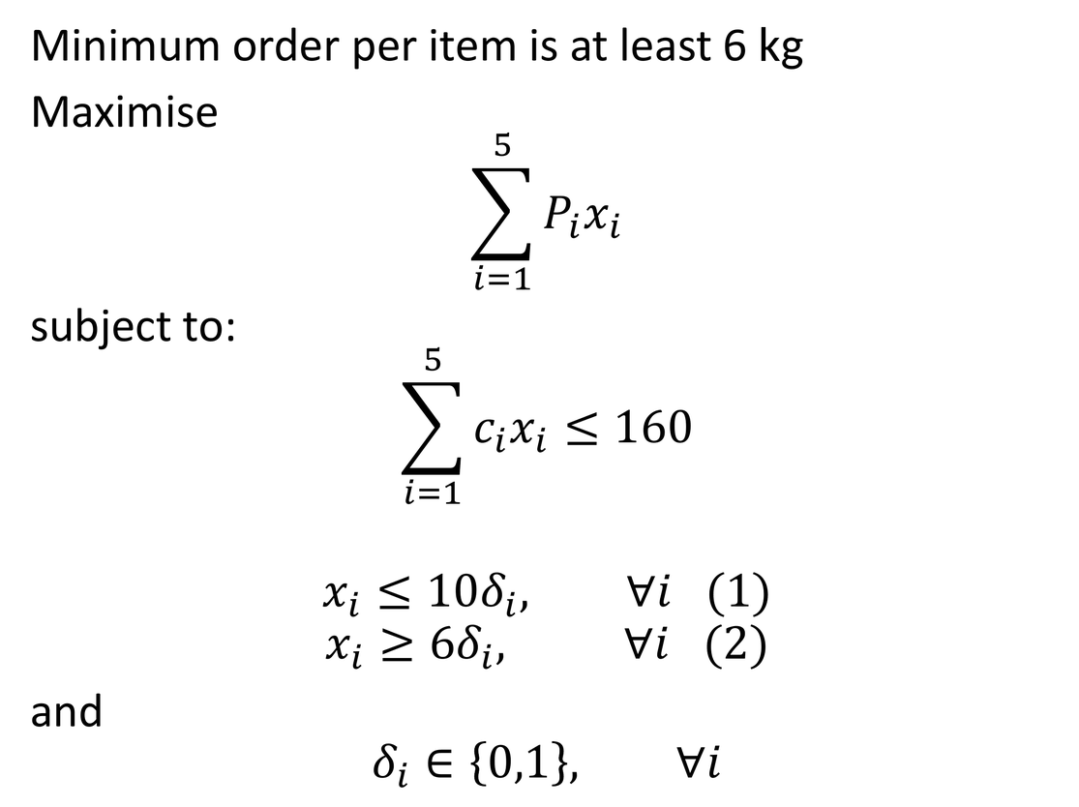
Binary Variables!
Item | Cost (per kg) | Expected Profit (per kg)
1 | 10 | 5
2 | 12 | 3
3 | 9 | 4
4 | 5 | 3
5 | 13 | 3
Minimum order per item is at least 6 kg
Maximise
$$\sum_{i=1}^{5}{P_{i}x_{i}}$$
subject to:
$$\sum_{i=1}^{5}{c_{i}x_{i}}≤160$$
$$x_{i}≤10δ_{i}, ∀i (1)$$
$$x_{i}≥6δ_{i}, ∀i (2)$$
and
$$δ_{i}∈\left\{0,1\right\}, ∀i$$
$δ_{i}$ – 1 if item $i$ picked, 0 if item $i$ not picked
When $δ_{i}=0$, constraints (1) and (2) become:
$$x_{i}≤0$$
$$x_{i}≥0$$
i.e. You don’t choose item $i$ – force lower and upper bounds of $0$
When $δ_{i}=1$, constraints (1) and (2) become:
$$x_{i}≤10$$
$$x_{i}≥6$$
i.e. You do choose item $i$ – force lower and upper bounds of $6≤x_{i}≤10$

Slide 28
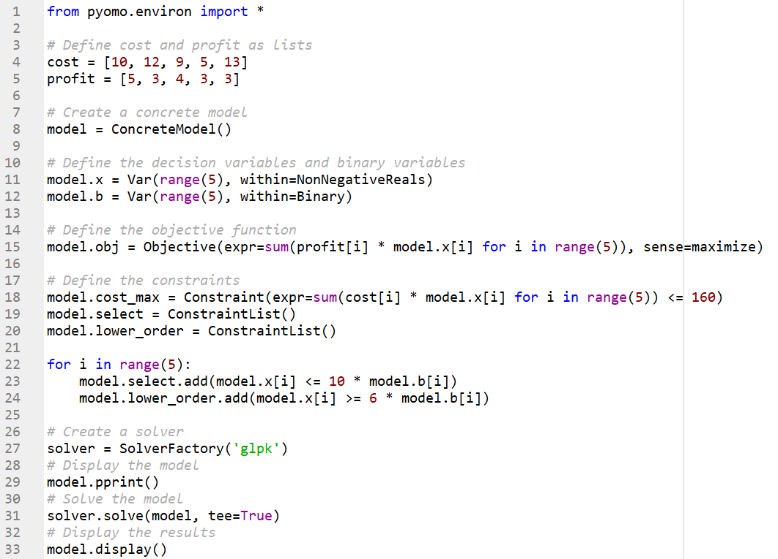
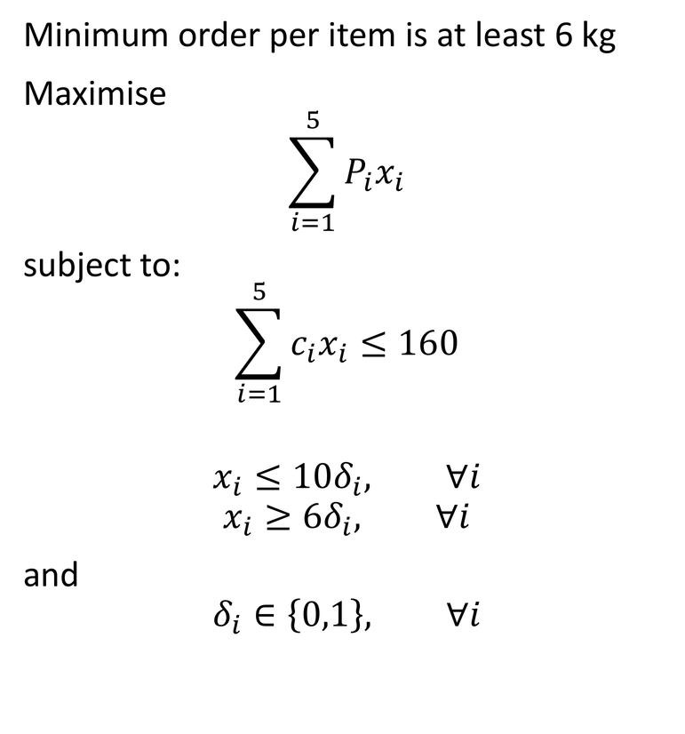
In Pyomo
Minimum order per item is at least 6 kg
Maximise
$$\sum_{i=1}^{5}{P_{i}x_{i}}$$
subject to:
$$\sum_{i=1}^{5}{c_{i}x_{i}}≤160$$
$$x_{i}≤10δ_{i}, ∀i$$
$$x_{i}≥6δ_{i}, ∀i$$
and
$$δ_{i}∈\left\{0,1\right\}, ∀i$$

Slide 29
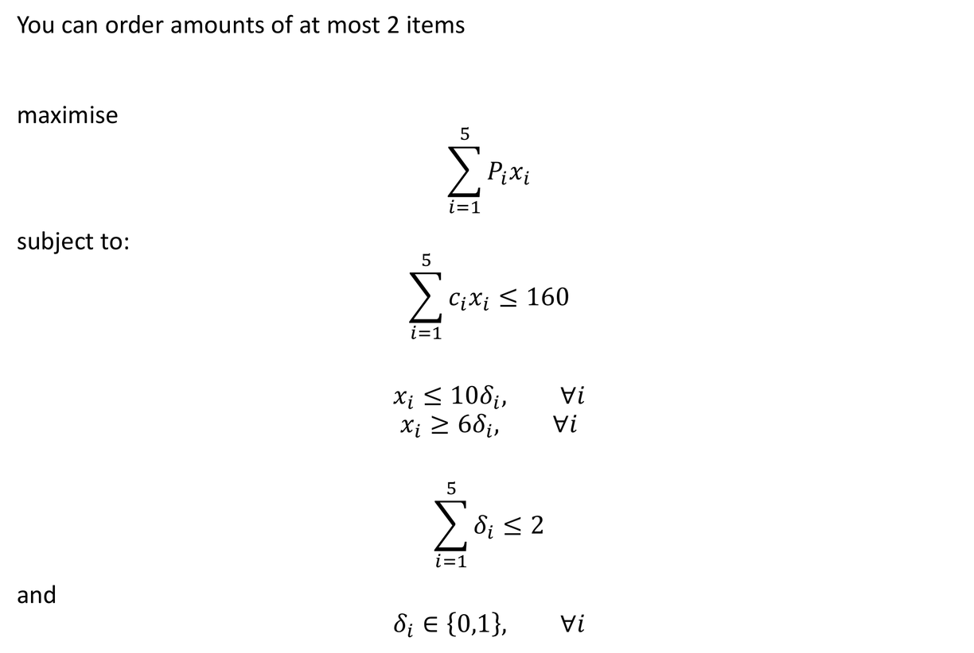
Additional Constraint
Item | Cost (per kg) | Expected Profit (per kg)
1 | 10 | 5
2 | 12 | 3
3 | 9 | 4
4 | 5 | 3
5 | 13 | 3
You can order at most 2 different items
maximise
$$\sum_{i=1}^{5}{P_{i}x_{i}}$$
subject to:
$$\sum_{i=1}^{5}{c_{i}x_{i}}≤160$$
$$x_{i}≤10δ_{i}, ∀i$$
$$x_{i}≥6δ_{i}, ∀i$$
$$\sum_{i=1}^{5}{δ_{i}}≤2$$
and
$$δ_{i}∈\left\{0,1\right\}, ∀i$$

Slide 30
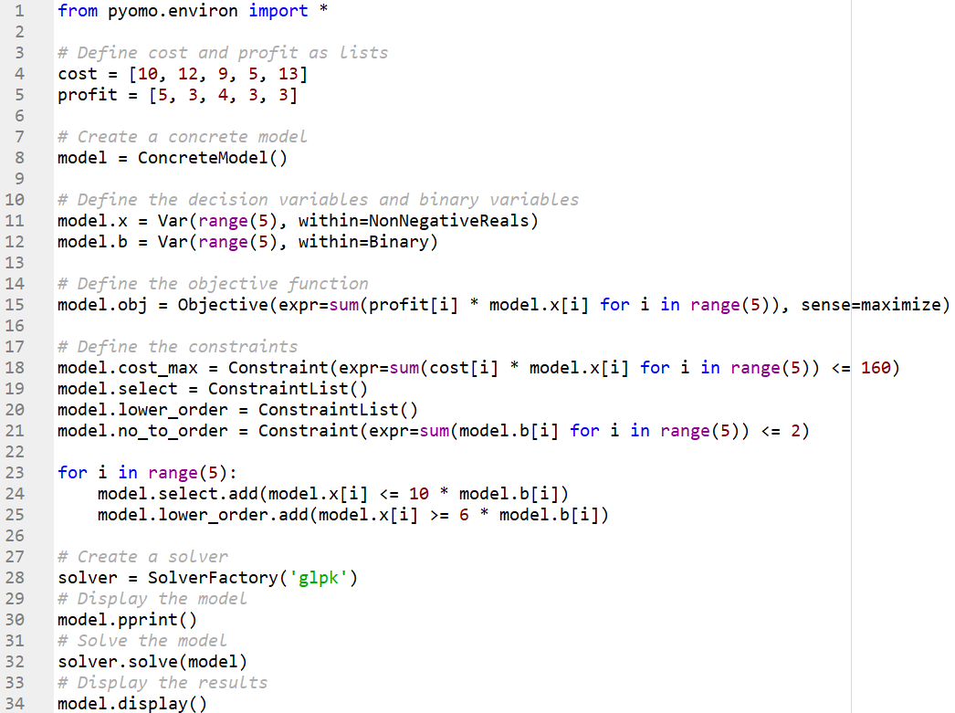
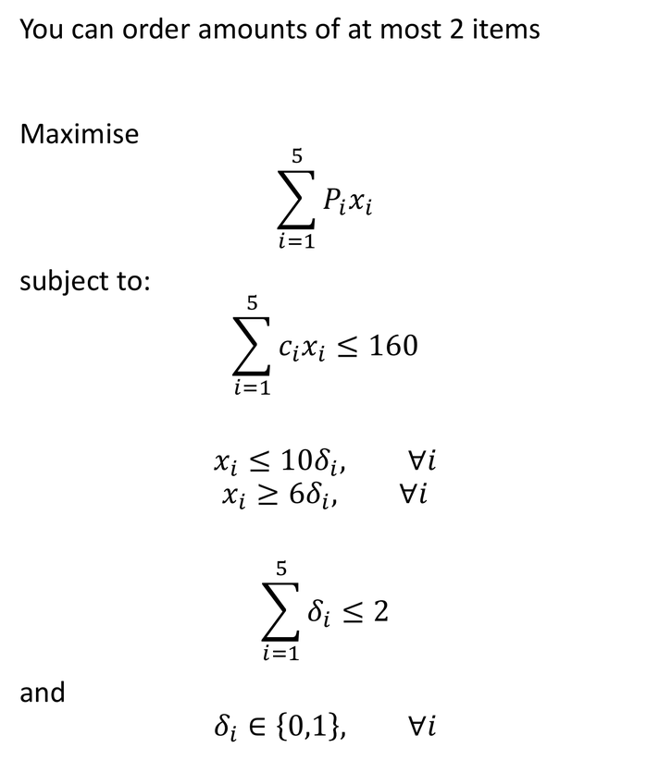
In Pyomo
You can order at most 2 different items
Maximise
$$\sum_{i=1}^{5}{P_{i}x_{i}}$$
subject to:
$$\sum_{i=1}^{5}{c_{i}x_{i}}≤160$$
$$x_{i}≤10δ_{i}, ∀i$$
$$x_{i}≥6δ_{i}, ∀i$$
$$\sum_{i=1}^{5}{δ_{i}}≤2$$
and
$$δ_{i}∈\left\{0,1\right\}, ∀i$$

Slide 31
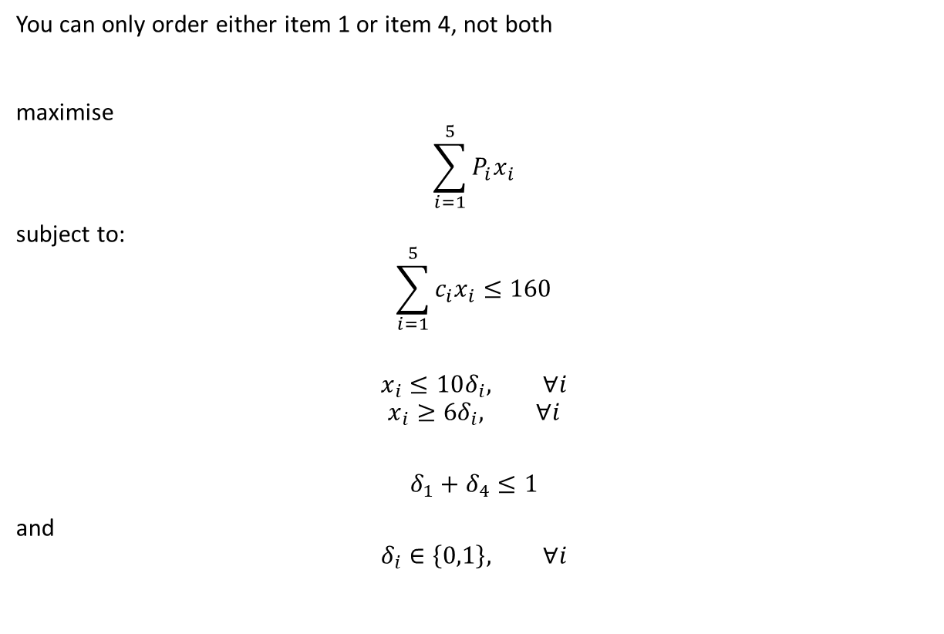
Purchasing Problem
Item | Cost (per kg) | Expected Profit (per kg)
1 | 10 | 5
2 | 12 | 3
3 | 9 | 4
4 | 5 | 3
5 | 13 | 3
You can only order either item 1 or item 4, not both
maximise
$$\sum_{i=1}^{5}{P_{i}x_{i}}$$
subject to:
$$\sum_{i=1}^{5}{c_{i}x_{i}}≤160$$
$$x_{i}≤10δ_{i}, ∀i$$
$$x_{i}≥6δ_{i}, ∀i$$
$$δ_{1}+δ_{4}≤1$$
and
$$δ_{i}∈\left\{0,1\right\}, ∀i$$

Slide 32
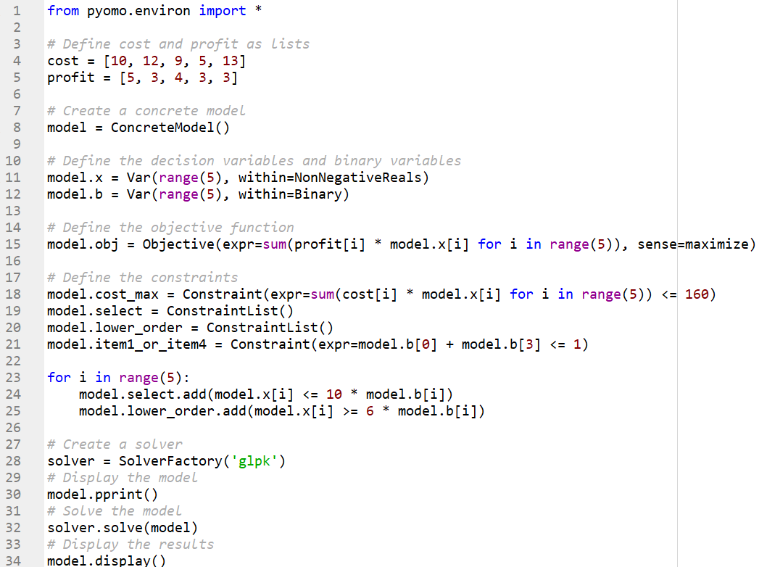
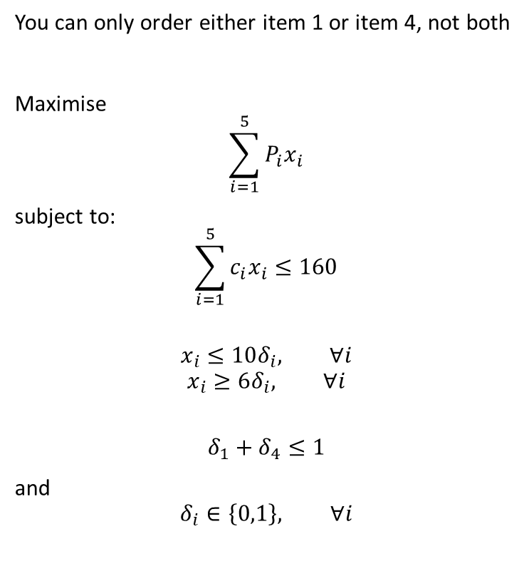
Purchasing Problem
You can only order either item 1 or item 4, not both
Maximise
$$\sum_{i=1}^{5}{P_{i}x_{i}}$$
subject to:
$$\sum_{i=1}^{5}{c_{i}x_{i}}≤160$$
$$x_{i}≤10δ_{i}, ∀i$$
$$x_{i}≥6δ_{i}, ∀i$$
$$δ_{1}+δ_{4}≤1$$
and
$$δ_{i}∈\left\{0,1\right\}, ∀i$$

